Slide 1

Topic :
Ethical Dilemmas in the Misuse of Data
Submitted To
A S M Kamrul Islam
Lecturer
Dept. of Computer Science and Engineering
Submitted By
GED- 409 213_D1
213902029 Shanto Mia
213902037 Md.Rabby Khan
213902072 Rabiul Hasan
213902078 Rayhan Chowdhury
213902104 Md.Shipon Miah
213902126 Mostak Ahmmed
1

Slide 2
Table of contents
01
04
02
05
03
06
Introduction
Ethical Theories for Data Use
Case Study – Cambridge Analytica
Solution
Key Ethical Dilemmas in Data Misuse
Conclusion and Q&A

Slide 3

Introduction to Data Misuse and Ethics
Data Misuse: Exploiting data in ways that compromise privacy, fairness, or consent
Ethical Dilemmas: Conflicts between business goals and ethical considerations
Purpose: Examine ethical issues and propose solutions to balance ethics with data use
3

Slide 4
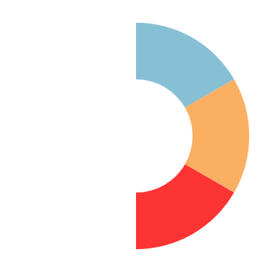
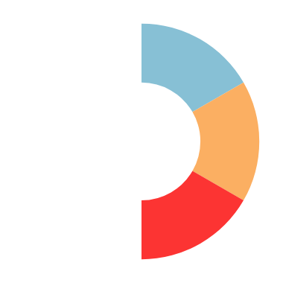

Case Study – Cambridge Analytica
Background:
Ethical Issues:
Impact:
Data used without consent to influence public opinion.
Privacy breach, user manipulation, lack of transparency
Eroded public trust, led to privacy law reforms
4

Slide 5

Key Ethical Dilemmas in Data Misuse
Privacy vs. Profit: Profit motives vs. user privacy
Transparency vs. Competitive Edge: Transparency in data practices vs. business secrecy
User Consent vs. Technological Innovation: Respecting consent amid data-driven innovation
Public Good vs. Individual Freedom: Using data for societal benefits vs. individual rights
5

Slide 6
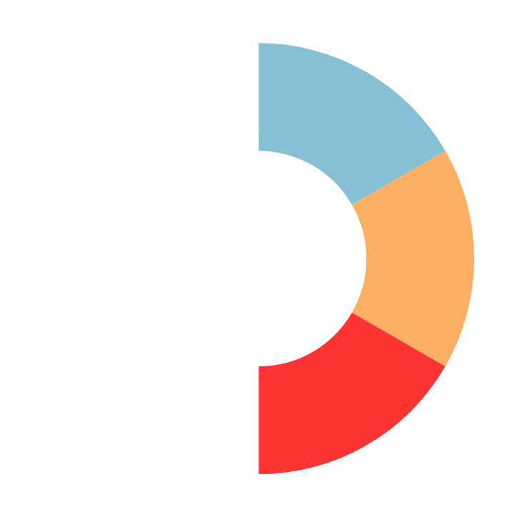



Ethical Theories for Data Use
Relativism:
Ethical considerations vary across cultural and social contexts
Justice Theory:
Promote fairness, equality, and respect for individual rights
Utilitarianism:
Maximize societal benefit while minimizing individual harm
6

Slide 7

Solution for Privacy vs. Profit
Dilemma: Profit generation often relies on user data, risking privacy
Solution Using Utilitarianism: Focus on aggregated data analysis to enhance profit without compromising individual privacy
Utilitarianism
7

Slide 8
Solution for Transparency vs. Competitive Edge
Dilemma: Revealing data practices could weaken competitive advantage
Solution Using Relativism: Disclose only essential practices affecting user data, safeguard business-sensitive information
8

Slide 9

Solution for User Consent vs. Innovation
Dilemma: Innovation requires data, often without full user consent
Solution Using Justice Theory: Offer clear consent options to honor user rights, maintain fairness in data use
Justice Theory
9

Slide 10

Solution for Public Good vs. Individual Freedom
Dilemma: Data use for public welfare may restrict individual freedom
Solution (Ethical Balance): Use anonymized data for public benefits, ensuring individual privacy
Ethical Balance
10

Slide 11
Conclusion
Summary: Balancing ethical principles with data use is essential for trust and fairness
Q&A: Open the floor for questions
11

Slide 12
Thank you
12

